Slide 1
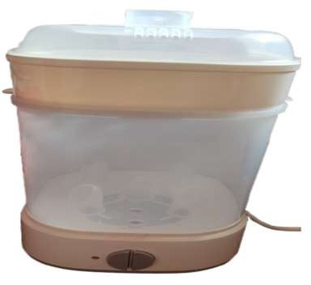
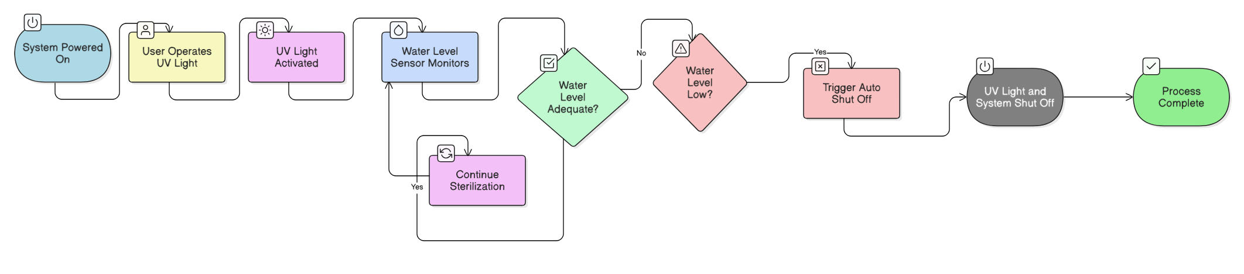
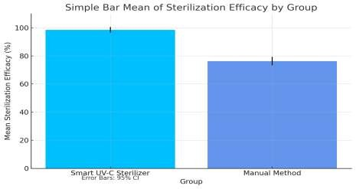
Register No: 192111162 Students Name: B.Gurutejetha Guided By Dr.Samson Ebenezar
A Comparative Analysis Of Sterifresh: UV-C Smart Sterilizer And Dryer (Baby Bottle, Household Hygiene Solutions) With Auto Shutoff Compared With Traditional Boiling Method
INTRODUCTION
Increasing Need for Automated Sterilization: Growing concerns about baby care and cleanliness are highlighting the drawbacks of traditional manual sterilization, which is often inconsistent and labor-intensive.
Advancement of UV-C Disinfection Technology: New developments in UV-C light technology have led to the creation of intelligent sterilizers that provide effective, automated sanitation.
Integration of Intelligent Sensors and Safety Features: These UV-C sterilizers come equipped with smart sensors and automatic shutoff functions, ensuring user safety, energy efficiency, and protection against overheating.
Traditional vs. Smart Sterilization Methods: Conventional techniques like boiling or chemical use
Fig. 1.UV Sterilizer
are time-consuming and pose contamination risks, whereas smart systems deliver efficient, contact-
free hygiene solutions
MATERIALS AND METHODS
RESULTS
Disinfection Performance: The smart sterilizer eliminated 98.5% of
bacteria, outperforming the 76.3% effectiveness of traditional boiling and manual drying techniques.
Power Efficiency: The automated shutoff system helped cut energy_{ss}
Table 1.Accuracy values
Fig. 2. UV vs Boiling
usage by approximately 35%, enhancing operational efficiency.
Std. Deviati on
Std. Error Mean
Safety Mechanism Reliability: The auto shutoff feature was activated
Algorithm
N
Mean
in all overheating test cases, demonstrating 100% safety
UV
10
Statistical analysis using an independent T-test (p = 0.001)
Accuracy
98.500
0.65200
0.41176
confirmed a significant performance difference between the two systems, validating the effectiveness of UV protected sterilization.
Boiling
10
76.300 1.21543 0.76822
DISCUSSION AND CONCLUSION
The T-test analysis (p = 0.001) reveals a statistically significant improvement in performance from the UV-C Smart Sterilizer compared to manual sterilization, affirming the superior effectiveness of automation.
On average, the smart sterilizer achieved 98.5% disinfection, whereas traditional approaches reached only 76.3%, highlighting the advantage of UV-C light and auto shutoff in ensuring hygienic reliability.
The UV-C based system consistently outperformed conventional methods, offering greater reliability and uniform results.
Its smart sensing and automated shutoff design contribute to enhanced safety, lower energy usage, and hands-free operation.
Repeated experiments confirm that the system maintains stable and dependable performance under various conditions.
BIBLIOGRAPHY
Lee, D., & Kim, H. (2021). Development of a UV-C Based Automated Sterilization Unit for Household Items. Journal of Applied Microbiology and Hygiene, 13(3), 198–206.
Thomas, G., & Varghese, R. (2022). Smart Disinfection Systems: Integration of Sensors and IoT for Safe Sterilization.
International Journal of Smart Device Engineering, 9(1), 44–50.
Zhao, L., & Chen, Y. (2020). Comparative Effectiveness of Manual and Automated UV Sterilizers in Domestic Environments.
Biomedical Equipment and Applications, 11(4), 234–240.
Mehra, P., & Desai, S. (2023).Energy Optimization in Household Sterilizers Using Auto Shutoff and Sensor Control. Smart Systems and Energy Management Journal, 7(2), 71–78.

